Slide 1

Sherwood Elementary
Annual Title 1 Meeting
August 17th 8:30 A.M and
August 17 4:00 P.M.

Slide 2
What is Title I ?
Title I, Part A of the Elementary and Secondary Education Act (ESEA)
  provides financial assistance to states and school districts to meet the needs of educationally at-risk students
  provide extra instructional services and activities for students
  Support for the areas of mathematics, reading, writing, and science

Slide 3

Title I Q & A
What can Title I do for my child?
The Title I program will provide your student with extra educational assistance beyond the regular classroom.
  Free Tutoring
  Extra educational material and supports
Which schools does Title I serve?
The program serves students in elementary and secondary (middle and high) schools who have demonstrated that extra assistance is needed. Title I also serves students who attend private schools.

Slide 4
Title I Q & A
The federal government provides funding to each state.
Each State Educational Agency sends money to its school districts, with the amount of funds determined by the number of low-income students attending that school.
Title I schools:
Identify the students at their school who need the most educational assistance based on the criteria that school has chosen.
Students do NOT have to be from low-income families to receive Title I services.
Set goals for improving the skills of educationally disadvantaged students at their school.
Measure student progress to determine the success of the Title I program for each student.
Develop programs for each individual student in order to support/supplement regular classroom instruction.

Slide 5
Title I programs generally offer:
Smaller classes or special instructional spaces
Opportunities for professional development for school staff
Extra time for teaching Title I students the skills they need
A variety of supplementary teaching methods
An individualized program for students
Additional teaching materials which supplement a student’s regular instruction

Slide 6

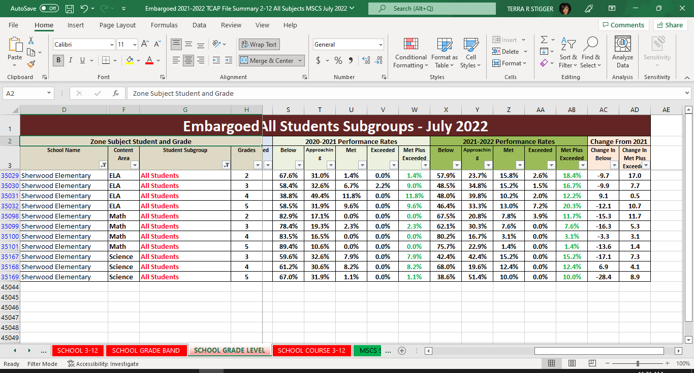


2021-2022 TCAP Data by Grade & Content

Slide 7
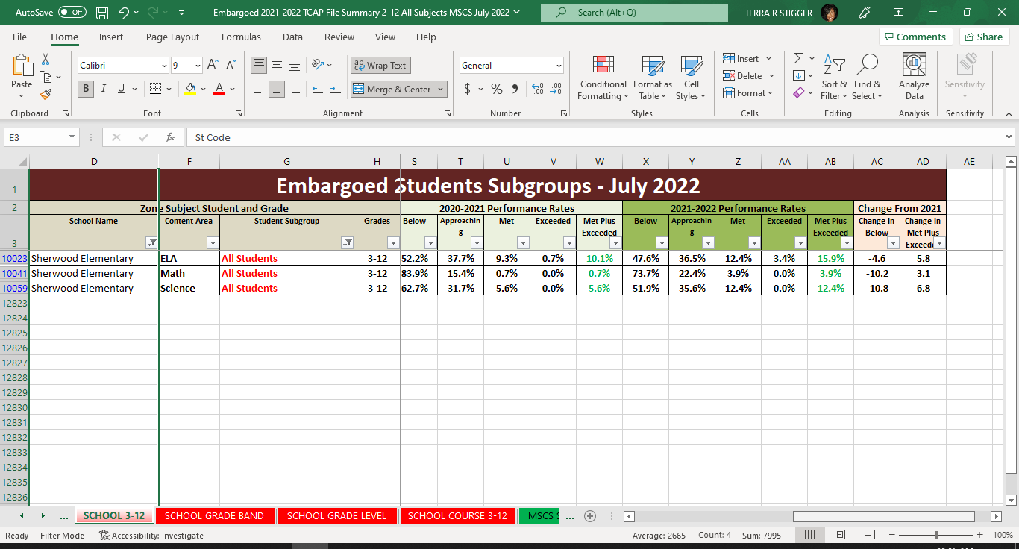
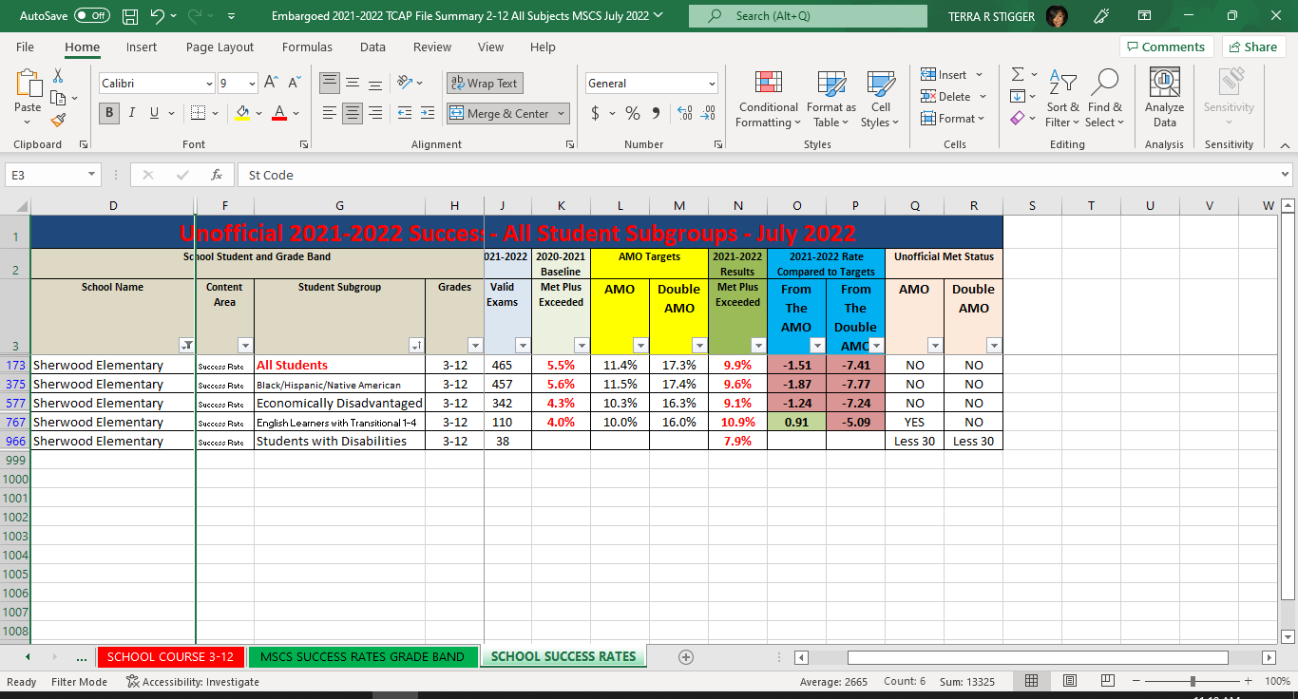
2021-2022 TCAP Data
Overall Success Rates

Slide 8
What can parents do?
You can influence the success of your student in school more than any teacher or federal program.
By becoming an active participant in the Title I parent involvement plan at your school, you will:
Serve as a role model, showing your
child that you support his/her education.
Assure that you are aware of your child’s educational progress; thereby demonstrating how important that progress is to you.
Teach your student that your input at the school is appreciated and that you support its efforts.

Slide 9
How can I be more involved?
You can become more involved by:
Joining the PTO
Supporting school extra-curricular activities
Volunteering at the school/Assisting with virtual lessons
Attending parent-teacher conferences
Communicating with your child’s teacher regularly, by writing notes, telephoning the school, email, etc.
Keeping your child’s teacher informed about events in his or her life which may affect his/her performance at school
Discussing with your child’s teacher and parent organizations other ideas for parent involvement

Slide 10


Parent Notifications

Slide 11
Parent Notifications
Title I, Part A
Language and Form
Parent’s Right-to-Know
LEAs Identified for Improvement
Schools
Annual Report Cards
Individual Student Assessment Reports
Progress Review
Technology being applied to their child’s education
Teacher Highly Qualified Status
Notes:
Language and Form
Information from the LEA relating to parent meetings, programs, and other activities must be sent to parents in a language and a format the parents can understand. This includes providing information in Spanish and any other language the LEA determines as practical.
Parent’s Right-to-Know
LEAs must report the following information:
Whether the teacher has met state certification criteria for the grade levels and subject areas in which the teacher is teaching;
Whether the teacher is teaching under emergency or other provisional status through which certification criteria have been waived;
The baccalaureate degree major of the teacher and any other graduate certification or degree held by the teacher, including the field of discipline of the certification or degree; and
Whether the child is provided services by paraprofessionals and, if so, their qualifications.
Parents must be notified that they have the right to request this information at the start of each school year. Note that this notification itself does not contain information on teacher qualification; it is simply a description of the type of information parents may request, if they wish.
Parents need to be aware that if a child is assigned, or taught by, a teacher who is not highly qualified for four or more consecutive weeks, a timely, separate notification must be sent to the parents.
LEA’s Improvement
School Improvement
If a school is found to be “In Need of Improvement”, the school must develop a school plan, and parents must be given an opportunity for input. In fact, any LEA may condition approval of the school’s improvement plan on community and parental support.
Parents must receive very detailed notices upon a school’s identification as being in need of improvement. The information parents receive must be truly useful to them in understanding the school and their options. When a school is identified for improvement, corrective action or restructuring, parents must receive prompt notice of:
What “identification” means and how the school compares to others;
The reasons for identification;
How the parents can become involved in addressing the school’s academic problems; and
The parents’ options regarding their right to seek a transfer of their children or to seek supplemental educational services.
The LEA also must publish and disseminate to parents and the public any actions taken by the school and the LEA to address the problems in the school. This notice must include:
What the school is doing to address the problem of low achievement;
What the LEA and SEA are doing to help the school; and
If applicable, a description of specific corrective actions or restructuring plans.
School Choice Option
Requires campuses that have been identified for School Improvement to, not later than the first day of school following such identification, to provide all students enrolled in the school with the option to transfer to another public school served by the LEA that may include a public charter school that has not been identified for school improvement
SES

Slide 12
Parent Notifications
Title III, Part A
LEP Student Progress and Achievement
LEAs and AMO Performance
Title X, McKinney-Vento Homeless Education.
Provide education to families that are homeless
Title IX, Subpart 2, Section 9532
    Persistently Dangerous Schools
    Student Victims of Violent Crime
Notes:
LEP Student Progress and Achievement (Title III)
Section 3302 of Title III statute requires parental notification for the following:
(a) IN GENERAL-Each eligible entity using funds provided under this title to provide a language instruction educational program shall, not later than 30 days after the beginning of the school year, inform a parent or the parents of a limited English proficient child identified for participation in, or participating in, such program of-
(1) the reasons for the identification of their child as limited English proficient and in need of placement in a language instruction educational program;
(2) the child's level of English proficiency, how such level was assessed, and the status of the child's academic achievement;
(3) the method of instruction used in the program in which their child is, or will be, participating, and the methods of instruction used in other available programs, including how such programs differ in content, instruction goals, and use of English and a native language in instruction;
(4) how the program in which their child is, or will be participating will meet the educational strengths and needs of the child;
(5) how such program will specifically help their child learn English, and meet age appropriate academic achievement standards for grade promotion and graduation;
(6) the specific exit requirements for such program, the expected rate of transition from such program into classrooms that are not tailored for limited English proficient children, and the expected rate of graduation from secondary school for such program if funds under this title are used for children in secondary schools;
(7) in the case of a child with a disability, how such program meets the objectives of the individualized education program of the child; and
(8) information pertaining to parental rights that includes written guidance —
(A) detailing —
(i) the right that parents have to have their child immediately removed from such program upon their request; and
(ii) the options that parents have to decline to enroll their child in such program or to choose another program or method of instruction, if available; and
(B) assisting parents in selecting among various programs and methods of instruction, if more than one program or method is offered by the eligible entity.
(Also in Title I Statute)
LEAs and AMAO Performance
AMAO Parental Notification - SEPARATE NOTIFICATION - In addition to providing the information required to be provided under subsection (a), the LEA that has failed to make progress on the annual measurable achievement objectives must separately inform parents of LEP students of such failure not later than 30 days after such failure occurs (as notified by TEA).

Slide 13
Interventions & Enrichment
iReady
Small Group RTI2 Intervention
ELD
Small groups with Specialized Educational Assistants

Slide 14
Elementary and Secondary Education Act (ESEA) Parents’ Right-To-Know
All parents have the right to request the following: • A teacher’s professional qualifications, which includes: state qualifications, licensure, grade/s certification, waivers • A teacher’s baccalaureate and /or graduate degree, fields of endorsement, previous teaching experience • A paraprofessional’s qualifications • An assurance that their child’s name, address, and telephone listing not be released to military recruiters
All parents will receive information on the following: • Their child’s level of achievement in each of the state academic assessments • Their option to request a transfer to another school within the district if their child is the victim of a violent crime at school • Their right to timely notification that their child has been assigned, or has been taught for four or more consecutive weeks by, a teacher who is not highly qualified
NINGUN NINO SE QUEDA ATRAS Derecho De los Padres de Familia a saber
Todos los padres tienen derecho a solicitar lo siguiente: • Las calificaciones profesionales de un maestro, que incluye: Calificaciones del Estado, Licenciatura, graos de la certificación, Renuncia a derecho • El Bachillerato a Titulo de graduación del maestro, campos de especialidad, experiencia previa • La calificaciones del profesional • Garantía que los datos de su hijo como nombre, dirección, numero de teléfono, no se entregan a los reclutadores militares
Todos los padres recibirán información sobre lo siguiente: • El nivel de rendimiento de su hijo en cada una de las evaluaciones académicas del estado • Su opción de solicitar un traslado a otra escuela del distrito si su hijo/a es victima de un crimen violento en la escuela • Su derecho a aviso con tiempo anticipado que su hijo/a ha sido asignado o ha estado bajo la enseñanza durante cuatro semanas consecutivas o más, de un maestro que no está altamente cualificado

Slide 15
Other Requirements
Title I, Part A
Reservation of Funds
District Parent Involvement Policy
Program Evaluation
Campus Parent Involvement Policy
School Parent Compacts
Coordination with Other Federal Programs
Title I, Part C
Migrant Parent Involvement Activities
Migrant and Section 1118
Information Provided In Language of Parent
Notes:
Reservation of funds:
If the LEA’s Title I, Part A entitlement is more than $500,000, the LEA shall reserve at least one percent of its Title I, Part A entitlement for parental involvement activities, including promoting family literacy and parenting skills. Parents involved in determining how $ used 95% of reserved 1% must go to campus PI activity.
LEA PI Policy:
The LEA has developed jointly with, agreed upon with, and distributed to, parents of participating children a written parent involvement policy that is incorporated into the LEA’s plan that establishes the expectations for parent involvement, and describes how the LEA will accomplish the following—
involve parents in the joint development of the LEA Plan and the process of school review and improvement
provide the coordination, technical assistance, and other support necessary to assist participating schools in planning and implementing effective parent involvement activities to improve student academic achievement and school performance;
Program Evaluation
build the capacity of schools and parents for strong parent involvement as
conduct, with the involvement of parents, an annual evaluation of the content and effectiveness of the parental involvement policy to—
improve the academic quality of the Title I, Part A schools;
identify barriers to greater participation by parents in activities;
use the findings of these evaluations in designing strategies for more effective parental involvement and revising, if necessary, the parental involvement policies
involve parents in the activities of the schools served.
Campus PI Policy
Each campus served under Title I, Part A has jointly developed with, and distributed to, parents of participating children a written parental involvement policy, agreed upon by such parents, that describes the means for carrying out the following parental involvement requirements—
policy involvement;
shared responsibilities for high student academic achievement;
building capacity for involvement; and
accessibility.
Parents are notified of the policy in an understandable and uniform format and, to the extent practicable, provided in a language the parents can understand. Such policy is made available to the local community and updated periodically to meet the changing needs of parents and the school.
School Parent Compact
Each campus served under Title I, Part A will jointly develop with parents, for all students served under Title I, Part A, a school-parent compact that outlines how parents, the entire campus staff, and the students will share the responsibility for improved student academic achievement, and the means by which the school and parents will build and develop a partnership to help children achieve the State’s high standards.
Such compact—
describes the responsibility of the campus to provide high-quality curriculum and instruction in a supportive and effective learning environment that enables the children served under Title I, Part A to meet the State’s student academic achievement standards, and the ways in which each parent will be responsible for supporting their children’s learning, such as monitoring attendance, homework completion, and television watching; volunteering in their child’s classroom; and participating, as appropriate, in decisions relating to the education of their children and positive use of extracurricular time; and
addresses the importance of communication between teachers and parents on an ongoing basis through, at a minimum—
parent-teacher conferences in elementary schools, at least annually, during which the compact is discussed as the compact relates to the individual child’s achievement;
frequent reports to parents on their children’s progress; and
reasonable access to staff, opportunities to volunteer and participate in their child’s class, and observation of classroom activities.
Coordination with other Federal Programs
coordinate and integrate parental involvement strategies under Title I, Part A with parental involvement strategies under other programs, such as Head Start, Reading First, Early Reading First, Even Start programs, Parents as Teachers, Home Instruction Program for Preschool Youngsters, and State-run preschool programs;

Slide 16
Who do I contact?
For more information regarding Title I, Part A
Jason Ellis
(901) 416-6624
ellisjc@scsk12.org.

